Slide 1
Music Store Analytics

Slide 2
Project analysis slide 3
Music Store Analytics
PROJECT DESCRIPTION
PROJECT APPROACH
TECH STACK USED
The project , Music store analytics aims to extract useful insights from raw data, using various database management tools and visualize them to increase the platform’s efficiency. The analysis of the music store is performed using various parameters.
The project was executed using structured query language. The data set was imported. Then, data extracting queries were implemented to obtain the required insights.
The project has been attempted with the help of Postgresql , the most widely used database out there, and is light weight and portable.

Slide 3
Project analysis slide 8
Music Store Analytics
TASK
OUTPUT
Q1. Who is the senior most employee based on the job title?
title first_name last_name
Senior General Manager Mohan Madan
CONCLUSION
QUERY
SELECT title, last_name, first_name
FROM employee
ORDER BY levels DESC
LIMIT 1
The query gives the senior most employee based on the job title.

Slide 4
Project analysis slide 8
Music Store Analytics
TASK
OUTPUT
Q2. Which countries have the most invoices?
billing_country c
USA 131
Canada 76
Brazil 61
France 50
Germany 41
QUERY
CONCLUSION
SELECT COUNT(*) AS c, billing_country
FROM invoice
GROUP BY billing_country
ORDER BY c DESC
The query gives the top 5 countries who have the most invoices

Slide 5
Project analysis slide 8
Music Store Analytics
TASK
OUTPUT
Q3. What are top 3 values of total invoice?
"total"
23.759999999999998
19.8
18.81
CONCLUSION
QUERY
SELECT total
FROM invoice
GROUP BY total
ORDER BY total DESC
LIMIT 3;
The query gives top 3 values of total invoice.

Slide 6
Project analysis slide 8
Music Store Analytics
TASK
OUTPUT
Q4: Which city has the best customers? We would like to throw a promotional Music Festival in the city we made the most money.
Write a query that returns one city that has the highest sum of invoice totals.
Return both the city name & sum of all invoice totals
"s" "billing_city"
273.24000000000007 "Prague"
QUERY
CONCLUSION
select sum(total) as s, billing_city
from invoice
group by billing_city
order by 1 desc
limit 1;
.
The query returns one city that has the highest sum of invoice totals.

Slide 7
Project analysis slide 8
Music Store Analytics
TASK
OUTPUT
Q5. Who is the best customer? The customer who has spent the most money will be declared the best customer.
Write a query that returns the person who has spent the most money.
"customer_id" "first_name" "last_name" "s"
5 R Madhav 144.54
CONCLUSION
QUERY
select customer.customer_id, customer.first_name, customer.last_name, sum(invoice.total) as s
from customer
join invoice
on customer.customer_id= invoice.customer_id
group by 1
order by 4 desc
limit 1;
The query returns the person who has spent the most money..

Slide 8
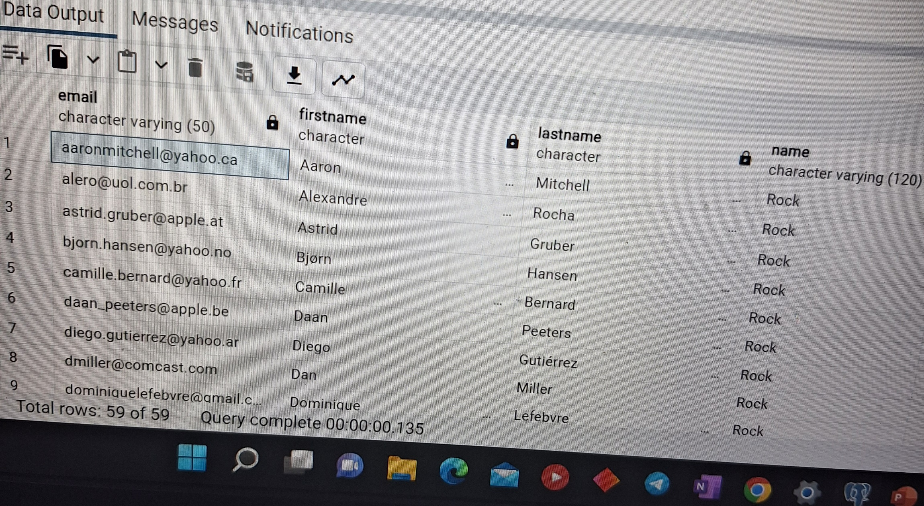
Project analysis slide 8
Music Store Analytics
TASK
OUTPUT
Q6. Write query to return the email, first name, last name, & Genre of all Rock Music listeners.
Return your list ordered alphabetically by email starting with A.
QUERY
SELECT DISTINCT email AS Email,first_name AS FirstName, last_name
AS LastName, genre.name AS Name
FROM customer
JOIN invoice ON invoice.customer_id = customer.customer_id
JOIN invoiceline ON invoiceline.invoice_id = invoice.invoice_id
JOIN track ON track.track_id = invoiceline.track_id
JOIN genre ON genre.genre_id = track.genre_id
WHERE genre.name LIKE 'Rock'
ORDER BY email;
CONCLUSION
The query gives the email, first name,last name and genre of all the rock music listeners.

Slide 9
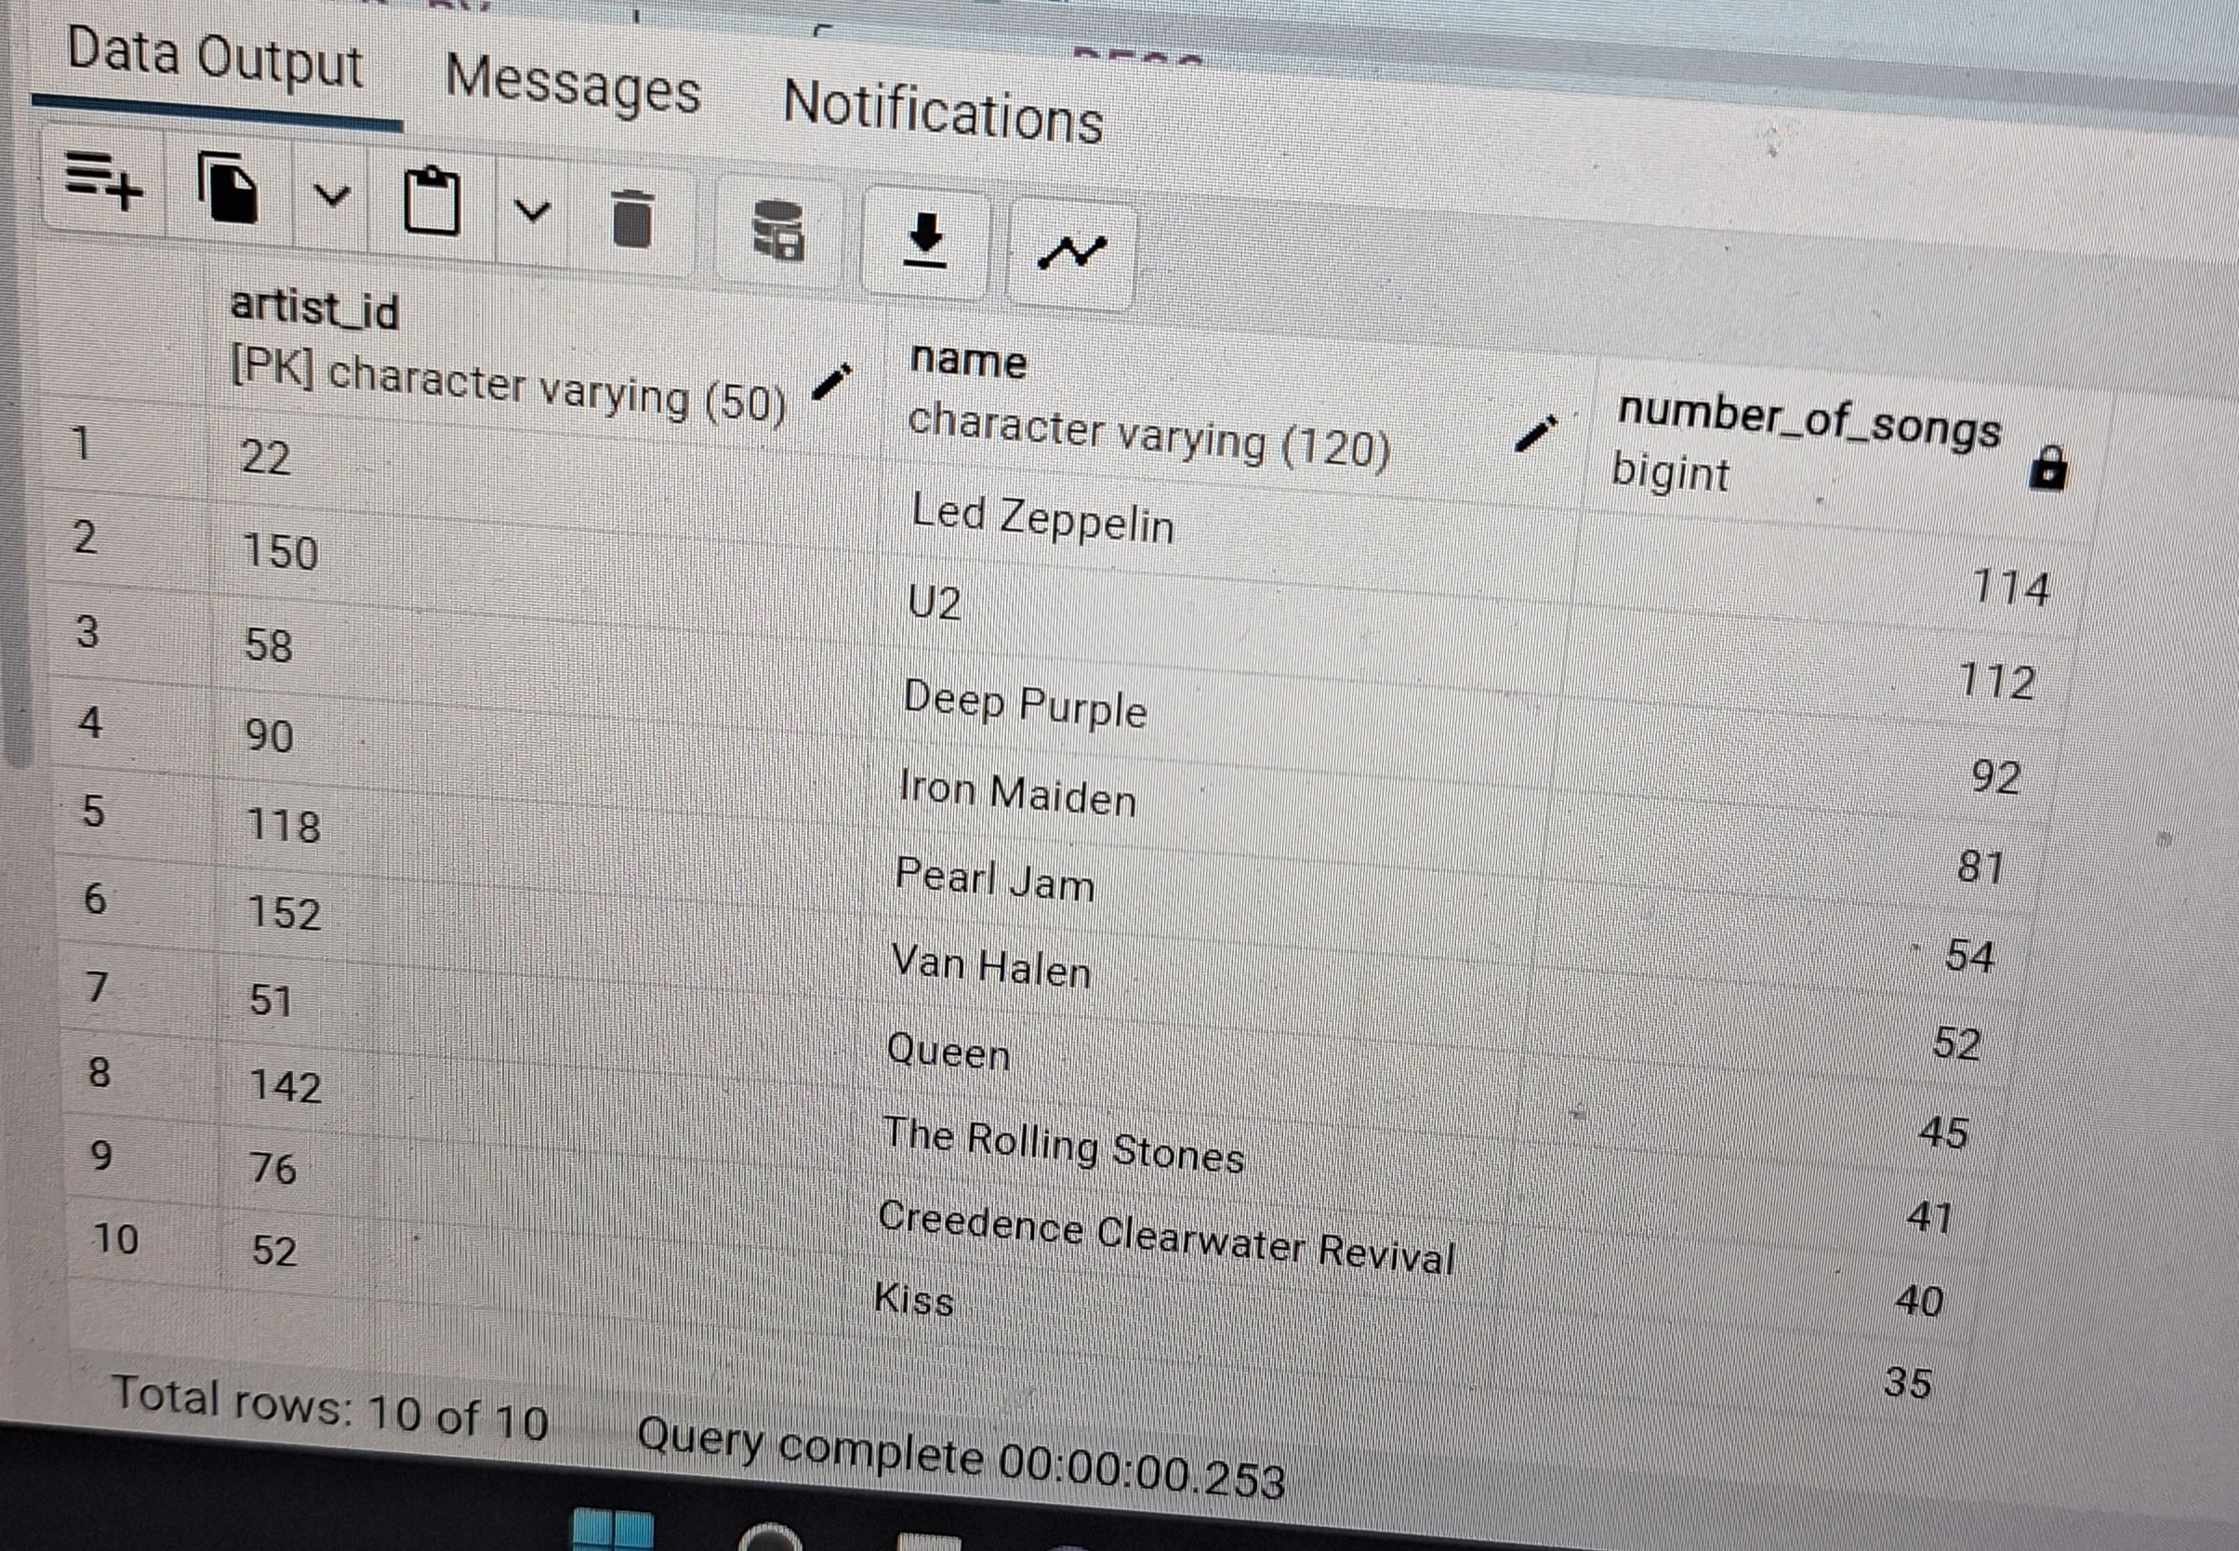
Project analysis slide 8
Music Store Analytics
TASK
OUTPUT
Q7. Let's invite the artists who have written the most rock music in our dataset. Write a query that returns the Artist name and total track count of the top 10 rock bands.
QUERY
SELECT artist.artist_id, artist.name,COUNT(artist.artist_id) AS number_of_songs
FROM track
JOIN album ON album.album_id = track.album_id
JOIN artist ON artist.artist_id = album.artist_id
JOIN genre ON genre.genre_id = track.genre_id
WHERE genre.name LIKE 'Rock'
GROUP BY artist.artist_id
ORDER BY number_of_songs DESC
LIMIT 10;
CONCLUSION
The query returns the Artist name and total track count of the top 10 rock bands.

Slide 10
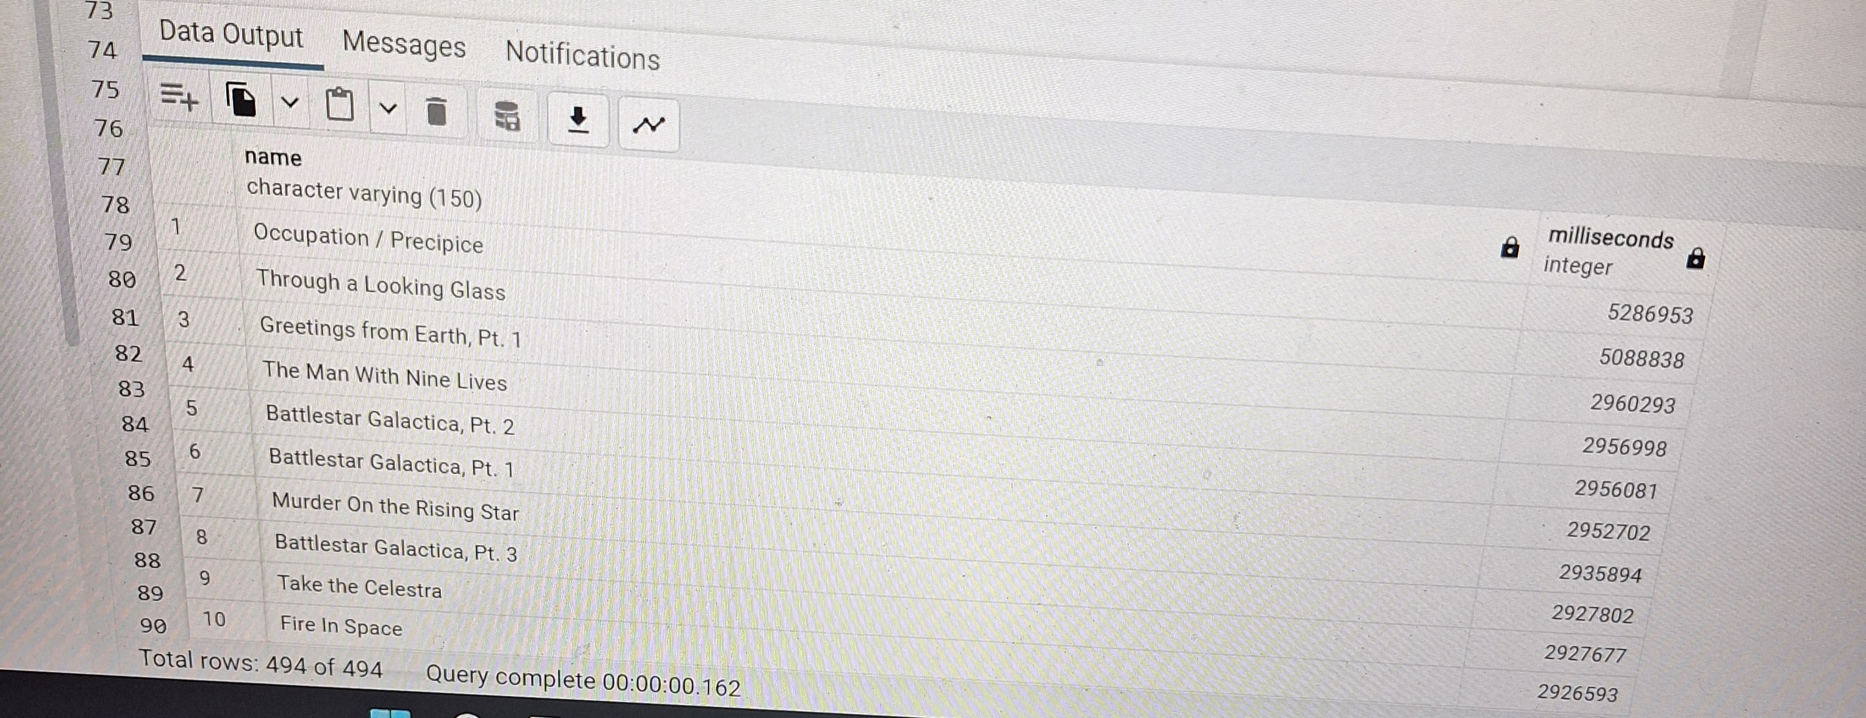
Project analysis slide 8
Music Store Analytics
TASK
OUTPUT
Q8. Return all the track names that have a song length longer than the average song length. Return the Name and Milliseconds for each track. Order by the song length with the longest songs listed first.
QUERY
CONCLUSION
SELECT name,miliseconds
FROM track
WHERE miliseconds > (
SELECT AVG(miliseconds) AS avg_track_length
FROM track )
ORDER BY miliseconds DESC;
.The query returns name and Milliseconds above the average song length.

Slide 11
Thank You

